Slide 1
How to make a powerpoint video

Slide 2
First
Go to the tab up top titled, ‘Slide show’
Click on ‘record slide show’
If you just press the button, it starts from the current slide
TO begin from the first slide, click the down arrow and select, ‘Record from beginning’

Slide 3
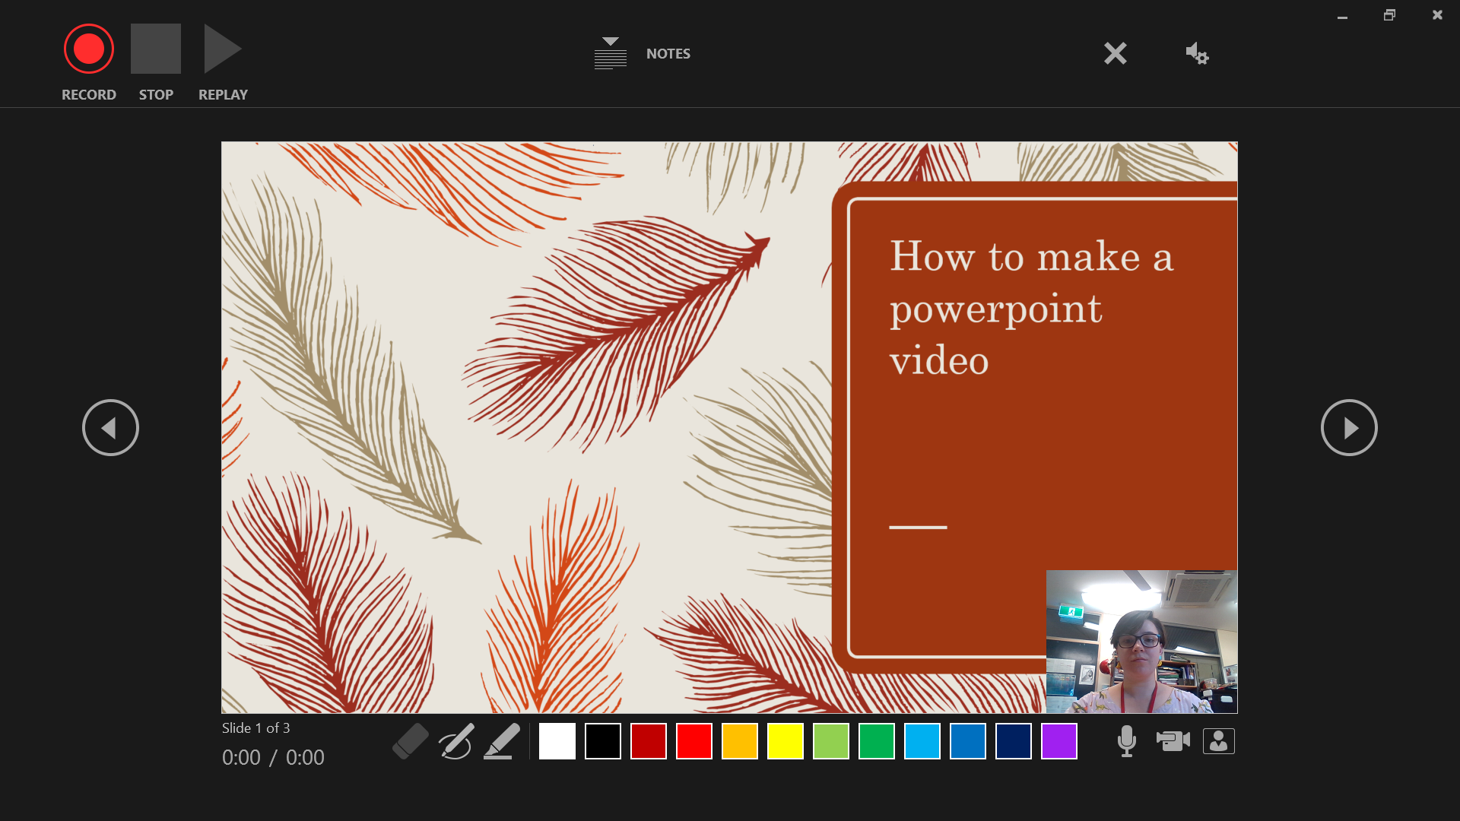
Your screen should now look like this

Slide 4
Your screen should now look like this
Click here to enable or disable video

Slide 5
Your screen should now look like this
Click here to begin recording

Slide 6
Your screen should now look like this
Use this to draw on the PowerPoint slide in real time

Slide 7
Once you’ve finished your video, your PowerPoint slides will look like this
This is the recording

Slide 8
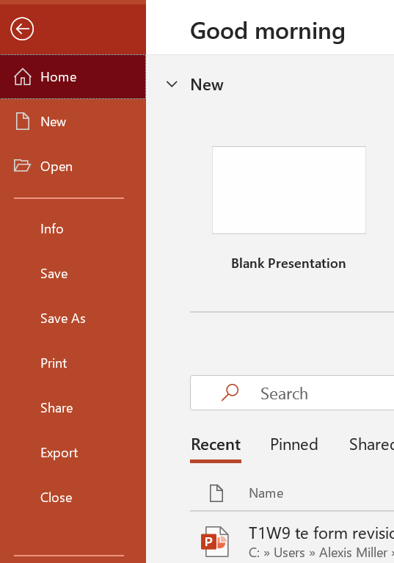
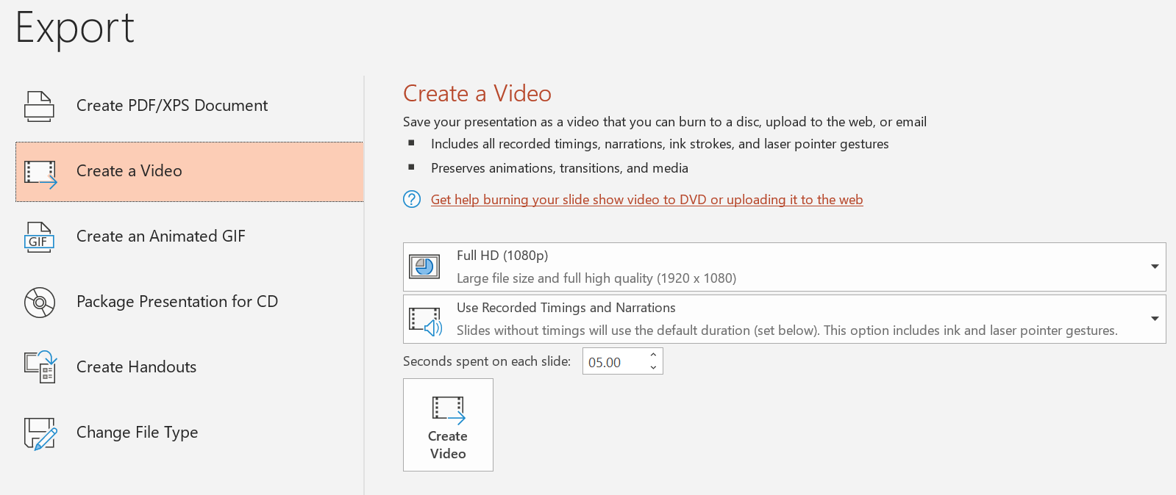
Go to home -> Export
In the export menu, select ‘Create a video’
There are 2 settings – You want yours to be on ‘Use recorded timings and narrations’
Once that is done, click ‘Create video’ and allow the file 3-5 minutes to export properly
Once that is done, you will have a powerpoint video!
Click here, instead of save

